Slide 1

DATS 6103: Project 2
World Bank - Commodities Prices since 1960
By: Andrew Jones

Slide 2







Contents
Overview
Commodities by Measurement type
Commodities by Percent Growth
Focus Subject: OPEC and Oil Prices
Focus Subject: Precious Metals
Conclusions

Slide 3
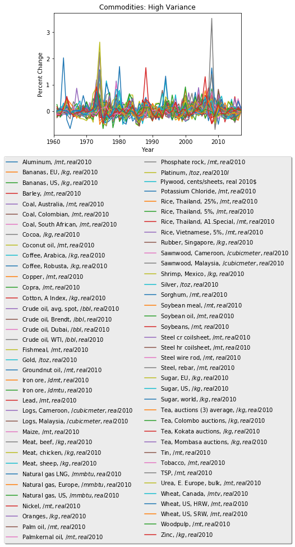
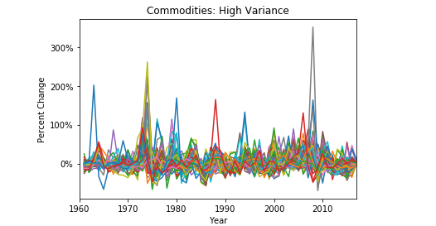
Commodities Show High Variance
75 Traded Commodities Assessed (2016)
Theme 1: Chart below shows the large scale on which price fluctuations consistently occur in commodities markets
The thick “band” drawn on the chart to encompass the majority of all price changes covers a range of approximately +/- 25%
≈ 50%

Slide 4



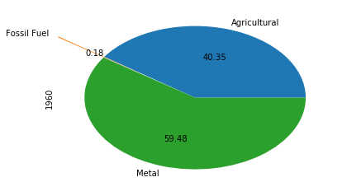
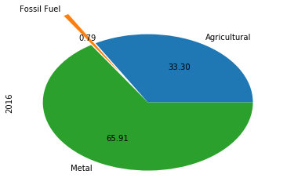
Comparative Product Makeup
Number of Traded Products: 1960/2016
Unequal number of commodities per category being assessed over the time period
Pie Charts show the proportion of money you would spend to receive exactly one unit of each good
In every category there are more goods (or markets for goods) being traded and tracked now than there were in 1960
Agricultural: 35/48
Metal: 11/16
Fossil Fuel: 5/11

Slide 5
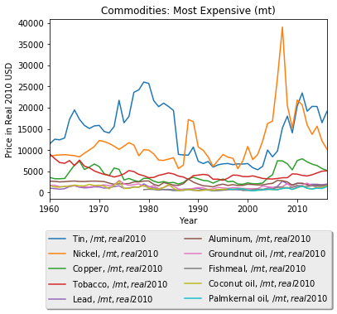
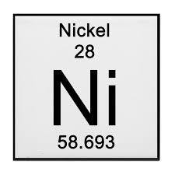

Most Expensive (Metric Tons)
Chart shows the top 10 most expensive commodities in Real 2010 USD for commodities measured in Metric Tons
Theme 2: Precipitous rise of the price of nickel was due to major pent up demand from china leading to “irrational investment” (telegraph)
Nickel is a major component in the manufacturing of stainless steel and some electronics (nickelinstitute)
Industrial Demand from China
Nickel on Periodic Table
The US Nickel coin is made of ≈ 25% nickel

Slide 6
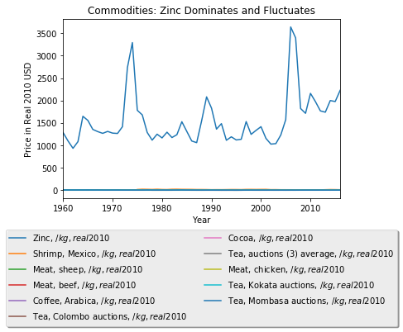
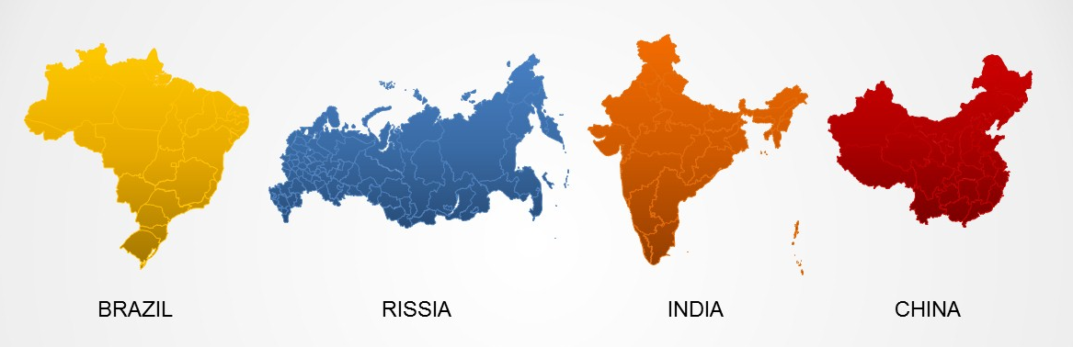
Most Expensive (Kilograms)
Chart shows the top 10 most expensive commodities in Real 2010 USD for commodities that are measured in Kilograms
In this chart Zinc clearly outclasses all of the other top 10 commodities that makeup the Kilograms grouping
Theme 2: Zinc is another industrial element that had large price spikes in the 2000’s due to the commodities boom originating from BRIC countries demand
Industrial Demand from China
BRIC Countries associated with 2000’s commodities boom

Slide 7
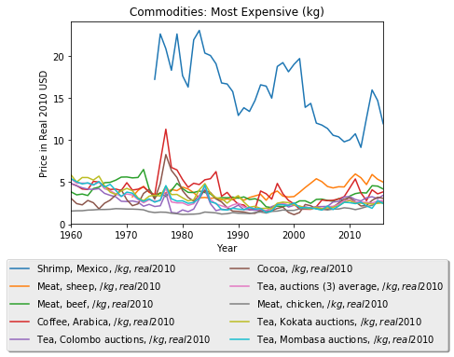
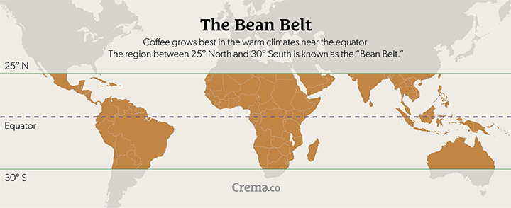
Most Expensive (Kilograms Continued)
Chart shows the analysis of the next 10 most expensive commodities after Zinc for products measured in Kilograms
Notice how vastly the scale has changed in this measurement ($1,000’s to just $10’s)
Shrimp is still significantly more expensive than other land based commodities
Cocoa and coffee’s price movements seem to reflect one another – similar producers around the equator?

Slide 8
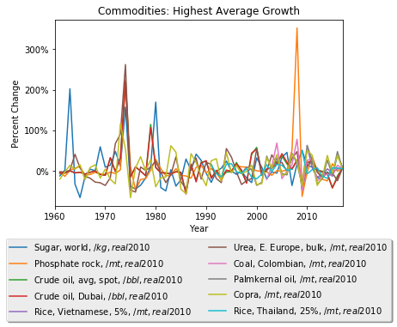


Commodities with Highest Average Growth
Chart shows the commodities that have experienced the highest average growth since 1960
1970’s commodities “supercylce” – a function of failing crops, OPEC formation and USD (international trading currency) decline. (radetzki)
Theme 3: The price for Phosphate rock (major component of fertilizer) had a boom & bust cycle as a result of China drastically revising it’s reported stockpiles and stiffer regulations requiring Biofuel use (i.e. ethanol) in Western countries. (cordell/white)
Interesting to note that the Average spot and Dubai traded market for crude oil made the list, but the WTI and Brent crude oil types did not
Commodities “Supercylce” – Broad growth across categories
Theme 3: Biofuels Push, China drastically revises stockpiles number

Slide 9
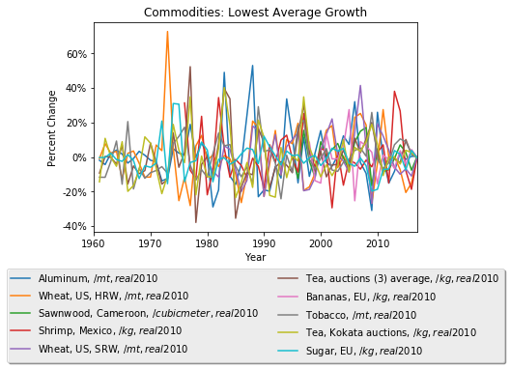
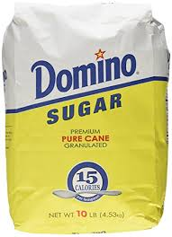
Commodities with Lowest Average Growth
This chart shows the commodities with the lowest average growth
Notice the way the scale differs from the previous graphic (+300% compared with -40% to +60%)
Theme 1: However there are still large fluctuations within this subset when compared against other asset classes like equities
Interesting to note that the Sugar World Avg. price made the previous most expensive list but the EU based sugar is now on the lowest average growth list – maybe due to regulations restricting sugar content?

Slide 10
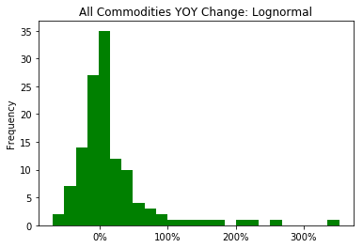
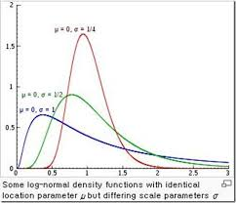
Distribution of Commodity Price Changes
This chart plots every commodities percent change from each year as a histogram
Takes the shape of a lognormal distribution – prices have seen more explosive spikes than drops
Useful basis of financial modeling for commodities traders and producers
Bins = 25

Slide 11
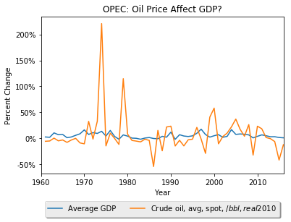
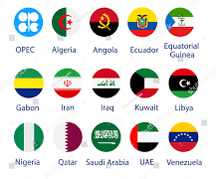
Focus Subject: Organization of Petroleum Exporting Countries (OPEC) and Oil Prices
This chart shows the relationship between the average spot price of oil and the average GDP of OPEC member nations combined
Obviously the percentage change in the commodity will strongly outweigh the change in countries GDP
But in general the movements reflect a similar pattern, especially before OPEC is formed
Oil slump post 2010 caused by cresting demand from emerging economies and vastly increased production in North America (forbes)
Theme 3: OPEC is Formed
Oil slump since 2010
OPEC Member Nations

Slide 12
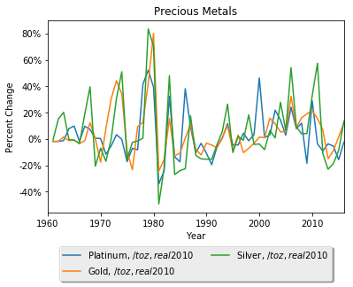


Focus Subject: Precious Metals
Theme 3: Cold War Tension: Iranian Revolution, USSR invades Afghanistan
This chart shows the price movements of specifically precious metals.
Precious metals are known to be a “haven” product that rise in price during economic downturns or political turmoil
Although most commodities have a relationship with the US dollar (as the international trade currency), that relationship is especially true for precious metals
Financial Crisis
US completely abandons gold standard

Slide 13



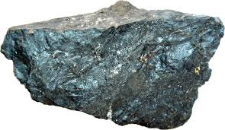
Conclusions
Theme 1: Commodities have very high degrees of price fluctuation as compared to most assets
Theme 2: During the late 2000’s many commodities had a boom period that led to a bust by 2010. This commodity boom was largely a consequence of pent up demand from the BRIC developing countries and especially China
Theme 3: Political events matter

Slide 14
Appendix

Slide 15
Learning Process and Sources
Learning Process:
First challenge of the project was simply to find an acceptable data set. Something interesting enough, challenging enough, while still realistic and relevant to the world. At a high level I knew combining two datasets in interesting ways was more likely to bring about useful and previously unbeknownst insights. Furthermore I’ve always been interested in finance and geopolitics so this was an interesting way for me to blend those two interests.
As always the data wrangling portion of the project takes a big allotment of time initially. However I was able to remember and reference code from Project 1 to speed that process up.
In some ways I was able to build upon the ideas and the structure of project 1 and then expand them to new areas. As both projects are referencing time series data, I was able to replicate many of the same descriptive type views as project 1, but also expand upon those ideas and show new things.
For example my second focus subject and idea for creating a histogram distribution on all percentage price movements were not ideas I had from the start. Often times for me, getting out of the code and starting to formulate a presentation leads to new ideas which brings me back to the code.
Lastly when investigating why certain fluctuations had occurred for a particular commodity or across commodities is when I started to formulate my themes. I think these themes or patterns are useful for understanding the market at a high level and certainly lend themselves to more investigation. If patterns are noticed at this high level (i.e. political events really matter) it alludes to further investigation you could perform (i.e. match news headlines NLP data and form the foundation of a predictive model).
Sources:
Primary Data Source - World Bank: Global Economic Monitor Commodities
Supplemental Data Source - World Bank: GDP Real 2010 USD
Radetzki, Marian. The Anatomy of Three Commodity Booms. radetzki.biz/rapporter/ThreeBooms_71.pdf. (radetzki)
Cordell, Dana & White, Stuart. (2011). Peak Phosphorus: Clarifying the Key Issues of a Vigorous Debate about Long-Term Phosphorus Security. Sustainability. 3. 2027-2049. 10.3390/su3102027. (cordell/white)
Evans-Pritchard, Ambrose. “Nickel price 'loses touch with industrial reality'.” The Telegraph, 6 Apr. 2007, www.telegraph.co.uk/finance/2806898/Nickel-price-loses-touch-with-industrial-reality.html. (telegraph)
“Where & Why Nickel Is Used.” Nickel Institute, www.nickelinstitute.org/NickelUseInSociety/AboutNickel/WhereWhyNickelIsUsed.aspx. (nickel institute)
McCain, Brian. “The Facts Behind Oil's Price Collapse.” Forbes, 9 Feb. 2015, The Facts Behind Oil's Price Collapse. (forbes)

